Slide 1
EC2 Assignment - 1
Create an Instance in us-east-1 (N. Virginia) region with an Ubuntu OS and install Nginx for making them web servers.
Change the default website with a hello world page.

Slide 2
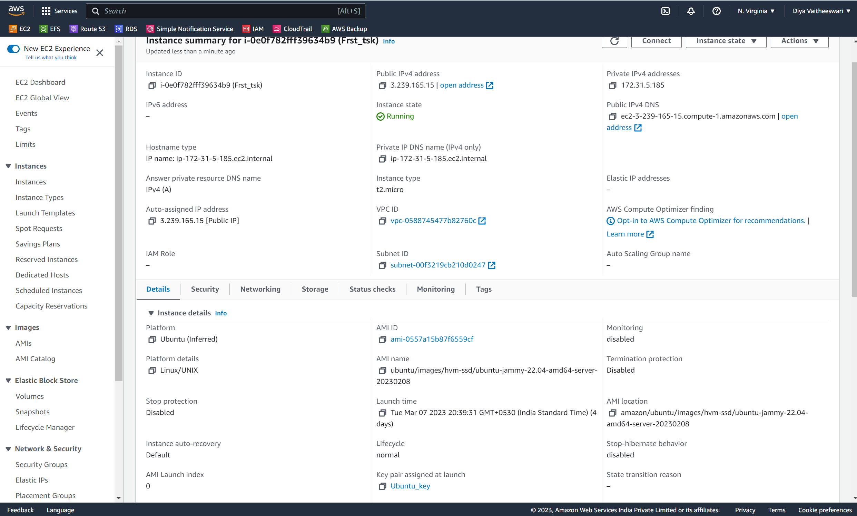
Solution:
Step -1:
→ Create an Instance in us-east-1 (N. Virginia) region with an Ubuntu OS.

Slide 3
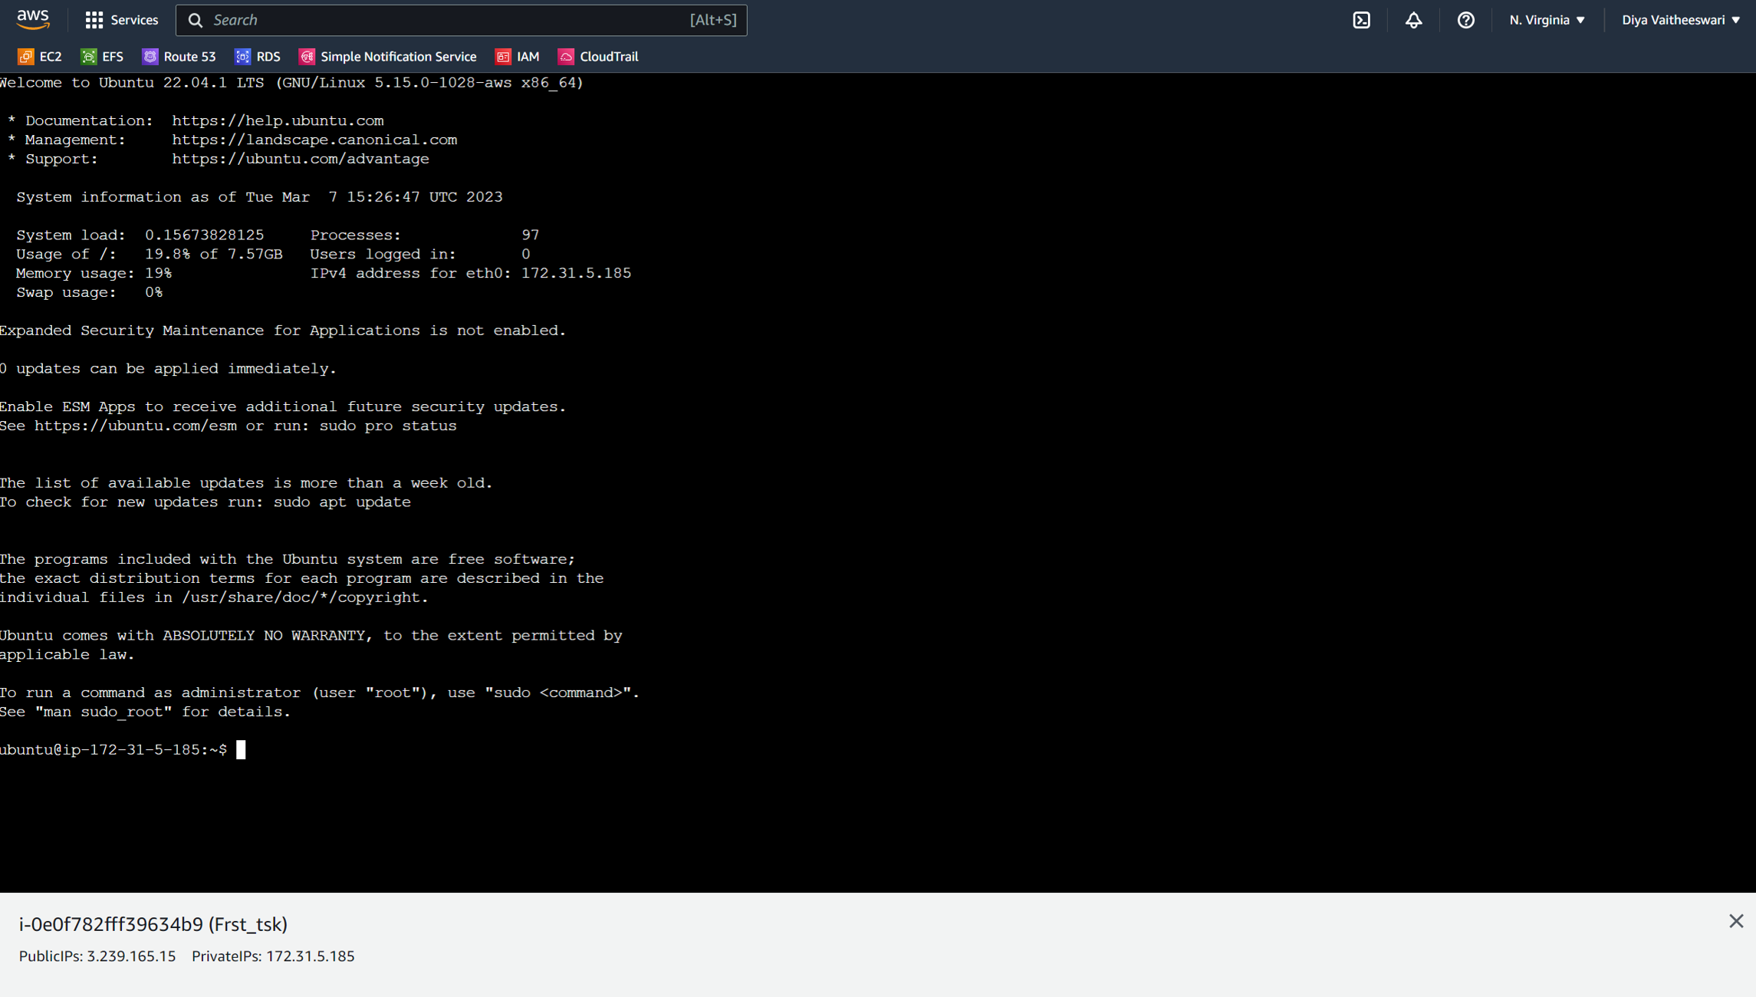
Step 2:
→Connect the instance.

Slide 4
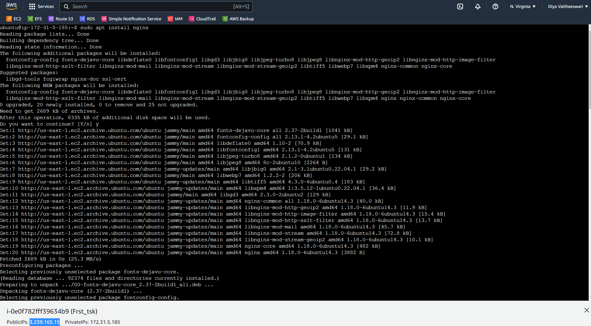
Step 3:
Install nginx and create the webpage using this comments.

Slide 5
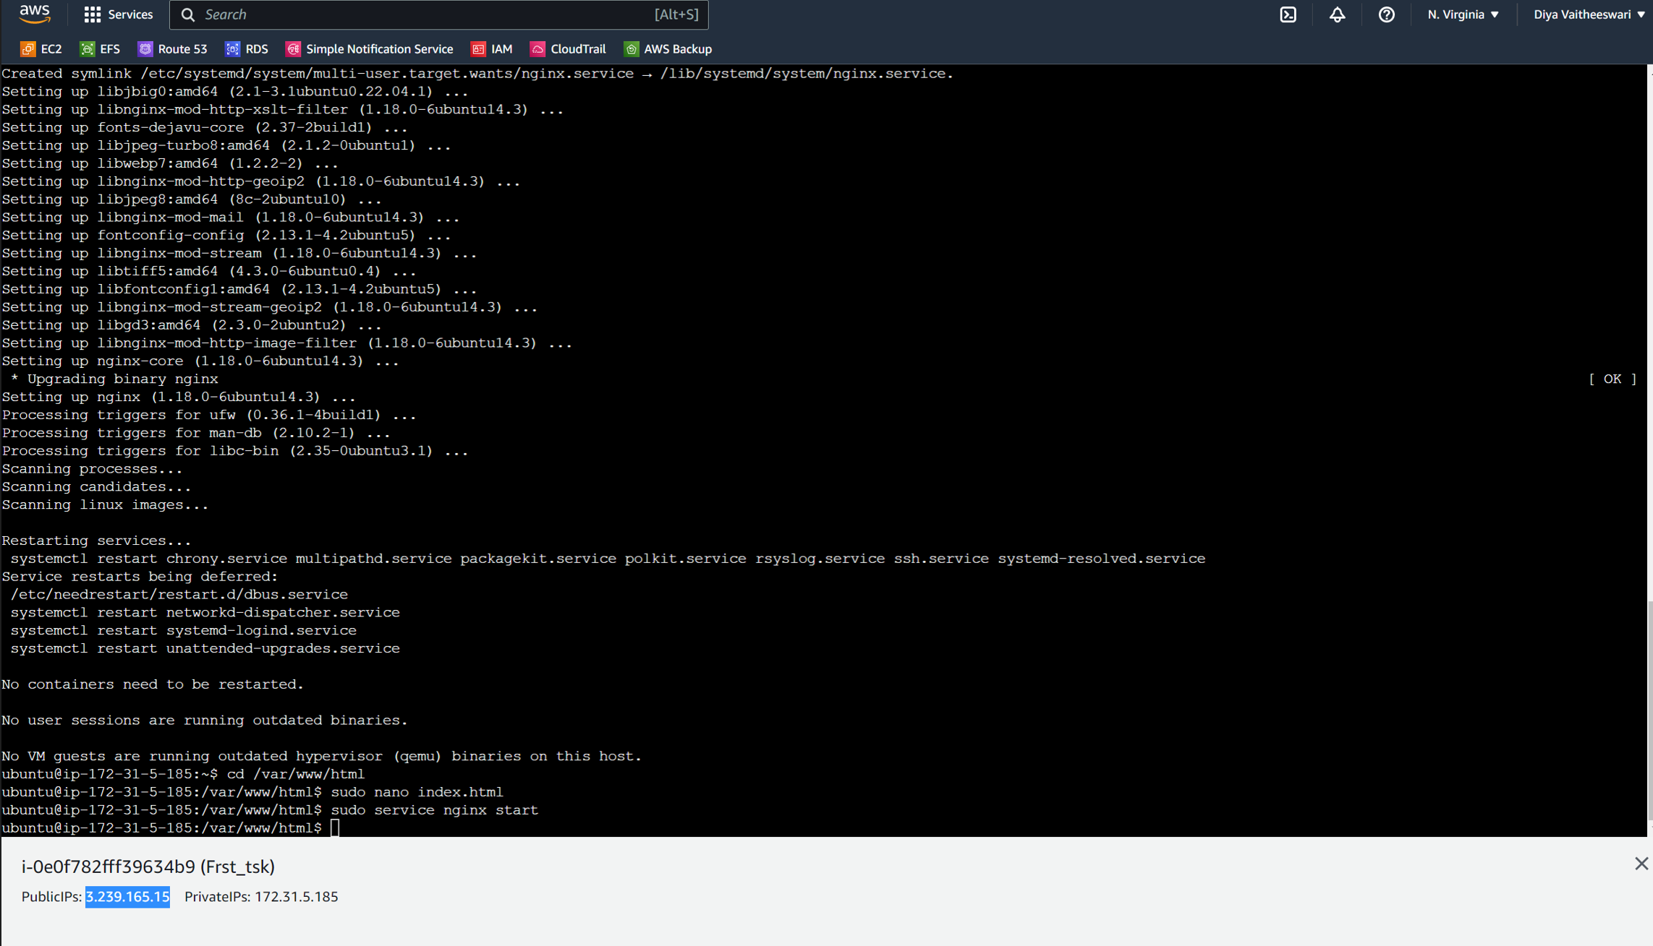

Slide 6
